Slide 1
Analysis of the Structure of the University Rankings
Deconstructing the evaluation system through data analysis and mathematical gradients
Author:
Maksym Honchar

Slide 2
Introduction and Problem Statement
Context
Key Research Question
Every year a lot of university rankings are published over the world. The Times Higher Education World University Rankings is one of the famous and influential ones.
Which of the five THE indicators has the greatest influence on a university's final position?
The Problem
Teaching
Research
Citations
International
Income
The official indicator weights are published and well known. However, a gap may exist between the official methodology and what is actually observed in the data. Is the ranking truly transparent?

Slide 3
Data and Preparation
Data Source
Data Cleaning
2,603
818
72
Total Records
Universities
Countries
Range ranks excluded
Missing values handled
Irrelevant columns removed
Analysis Focus
2015
201
1201
Year
Universities in data set
All years combined

Slide 4
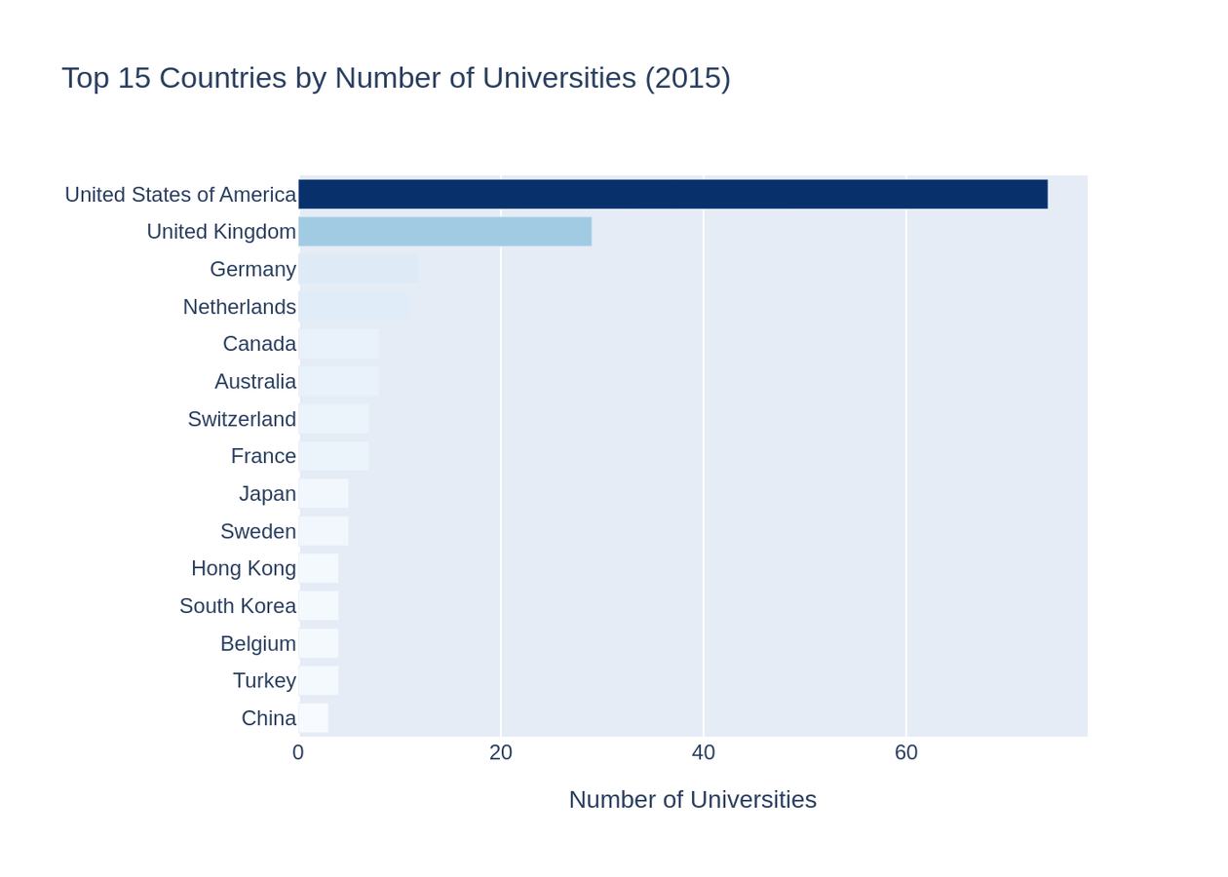
Geography of Global Leaders
Key Finding
The distribution shows clear dominance patterns
United States
74
United Kingdom
29
Germany
12

Slide 5
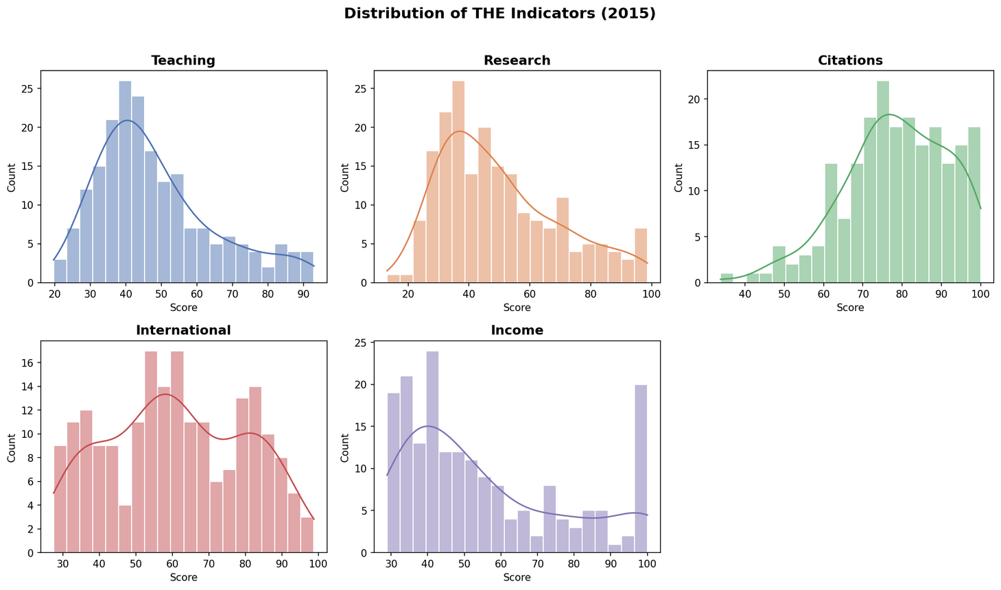
Distribution of Scores Across Indicators
Citations
78.6 mean score
Teaching & Research
48-50 mean score
Income
55.5 high variability

Slide 6
The Gradient Approach
Core Concept
Methodology
The final score is treated as a mathematical function of five variables
Using linear regression to extract empirical weights. The coefficients represent the gradient components
The Gradient
Gradient Components:

Slide 7
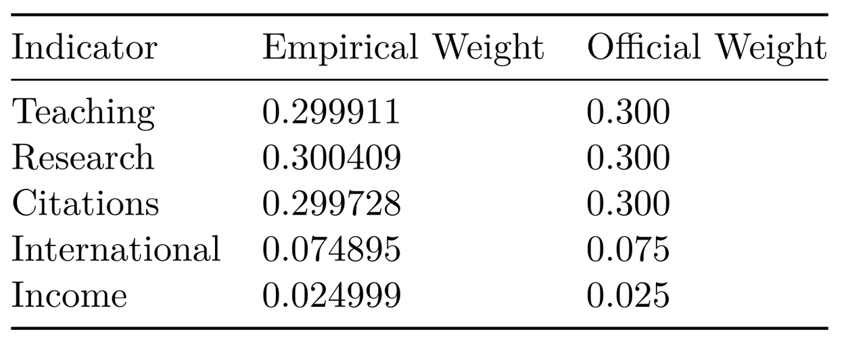
Empirical Weights vs. Official Weights
Three Heavyweight Pillars
Teaching 30%
Research 30%
Citations 30%
Nearly perfect agreement between calculations and official methodology. The THE ranking strictly follows its stated logic.
Secondary Factors
International 7,5%
Income 2,5%

Slide 8
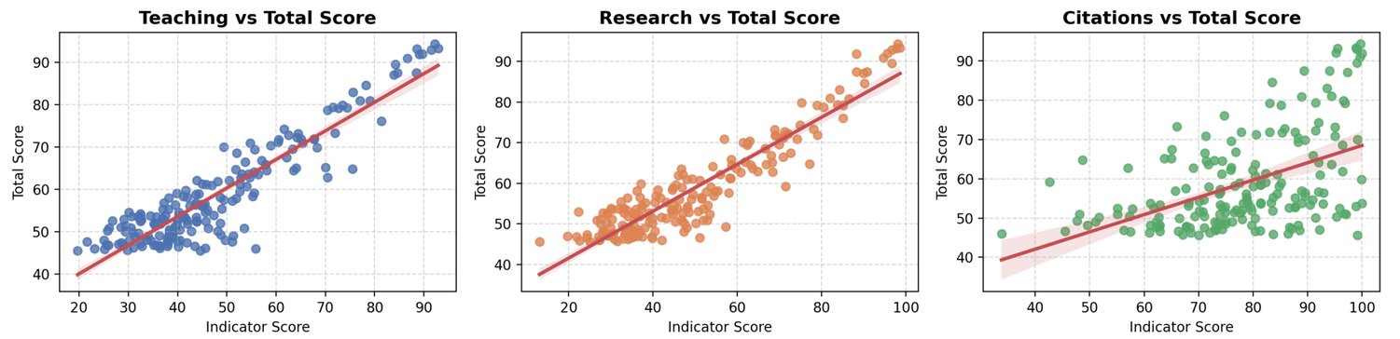
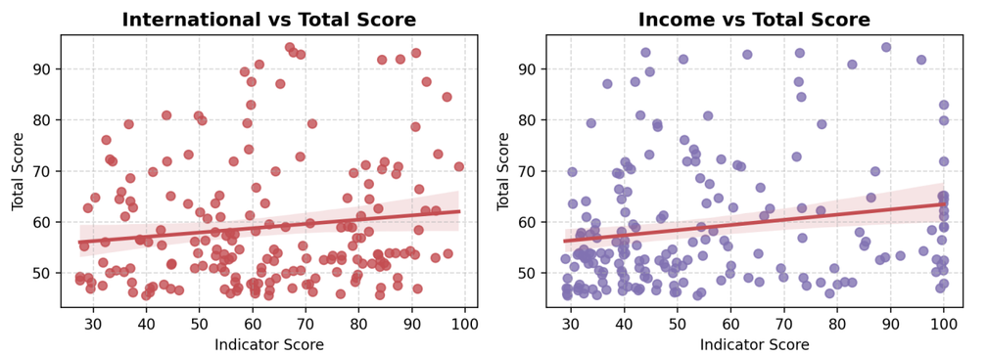
Linearity Verification
Strong linear alignment observed in Teaching / Research / Citations indicators.
International and Income have high dispersion

Slide 9


Final Takeaways
Transparency Confirmed
Geographical Context
THE's grading system is not a "black box"—it is mathematically predictable and follows stated methodology with near-perfect precision.
Current ranking rules favor the Anglo-Saxon university model, explaining the dominance of US and UK institutions in the top positions.
Strategic Focus
Teaching
Research
Citations
30%
30%
30%
74
Universities
29
Universities

